Slide 1

x / 10 People
Insufficient physical activity

Slide 2
4 / 10 People
Insufficient physical activity
(Nik-Nasir et al., 2022)
Notes:
4/10 insufficient physical activity
insufficient is defined as less than 600 MET (metabolic equivalent of task) minutes per week
One MET is defined as the amount of energy a person uses while sitting still.
varied background of age, gender, income level, race, education, occupation
mean age is 51.68
at least a primary level of education
study name: Physical Activity in Malaysia: Are We Doing Enough? Findings from the REDISCOVER Study
study year: 2022

Slide 3
Introducing…
Notes:
Feel free to remove the drumsoll sound effect yaaa I just put to see the effect

Slide 4

Introducing…

Slide 5
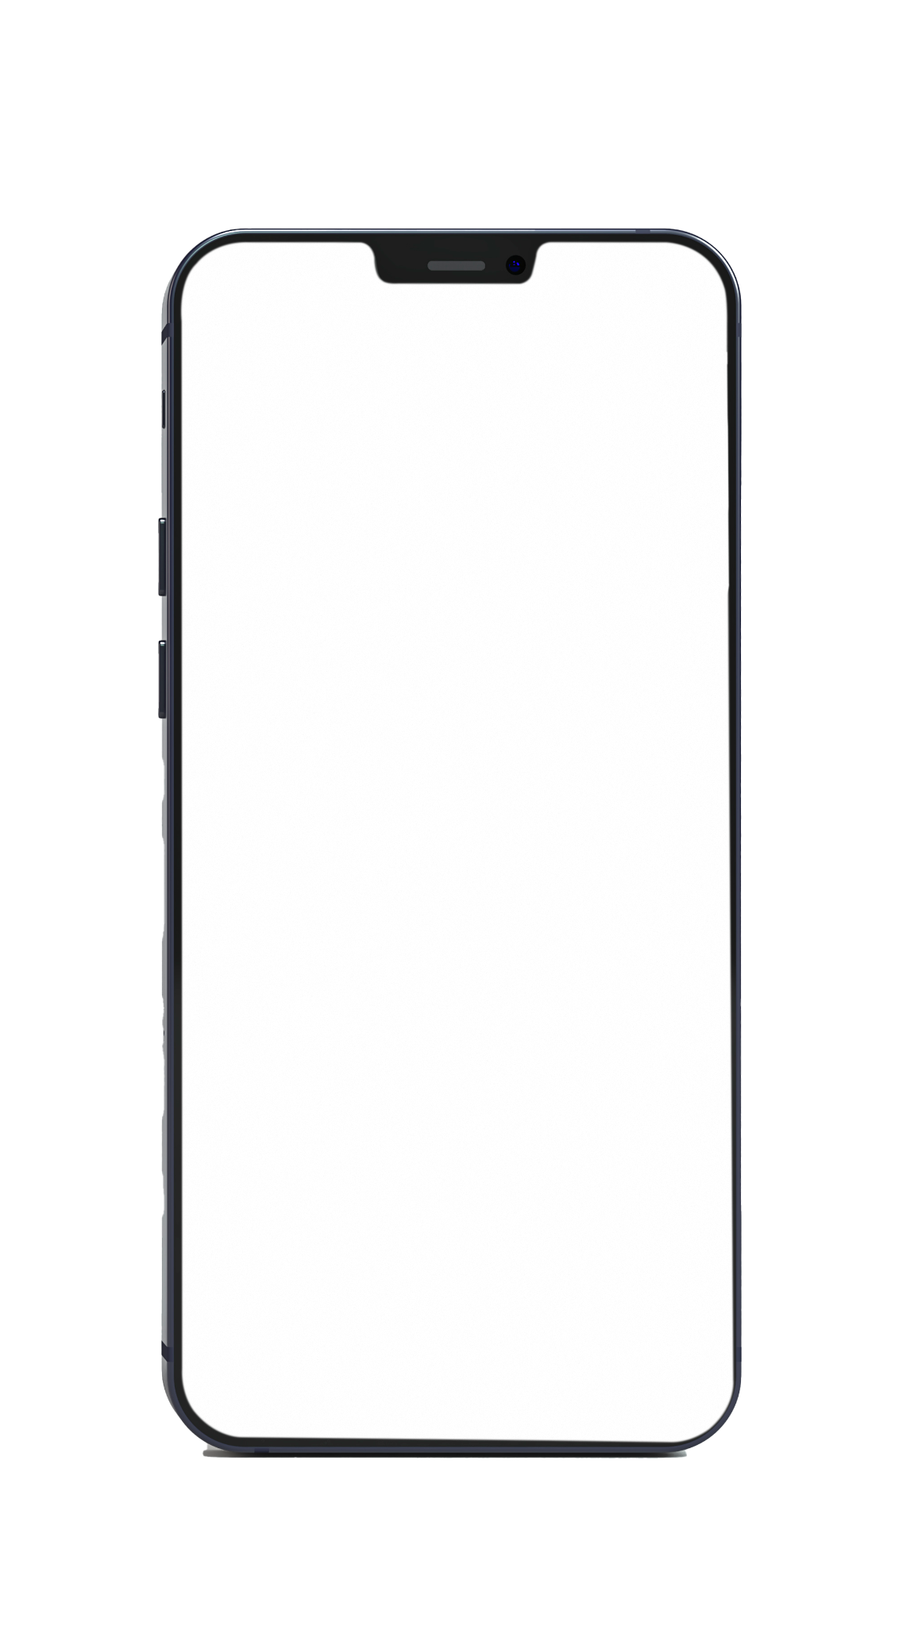
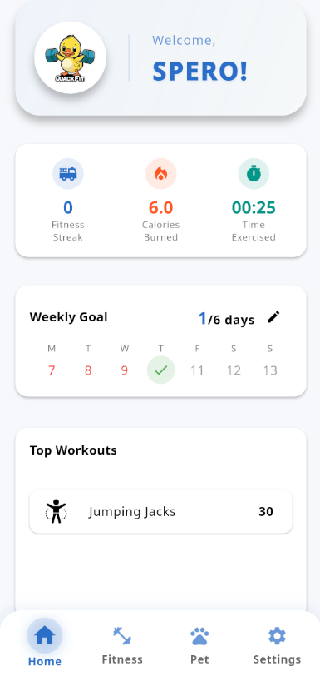
QuackFit
An AI-Powered Personalised Fitness Application

Slide 6


Main Idea
Use AI to generate fitness plans with home workouts and verify workout completions.

Slide 7
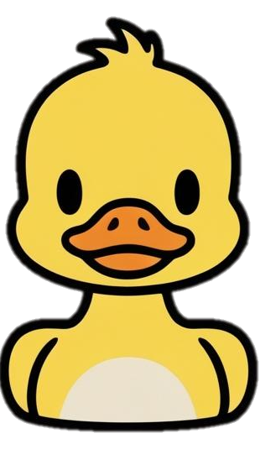
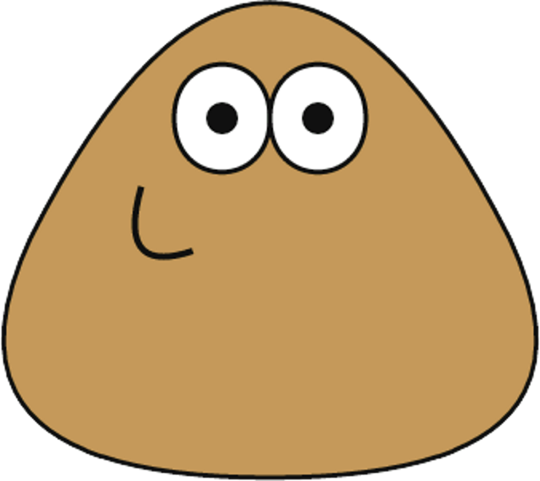
Gamification
Virtual Pet (Duck)
Calories Burnt = Flames Earned

Slide 8

Goal
To promote a long-term fitness habit

Slide 9



1
PROBLEM STATEMENT
2
3
Lack of adaptive and personalized fitness plans ^{[1]}
Overlooked safety instructions ^{[2]}
Losing interest and motivation ^{[3]}
[1]: A common gap in the current personalisation approach of fitness applications in the market is the lack of users’ preferences as input in the personalisation algorithm (Tong et al., 2022)
[2]: Some of the recently used apps focus too much on doing an abundance of exercises rather than doing them safely and correctly (Kurup et al., 2022).
[3]: On average, 6 months after the initial adoptions and installation of health and fitness apps, nearly half of the users are prone to lose interest and would most likely discontinue using these applications (Feng et al., 2020)
Notes:
airin

Slide 10

1
OBJECTIVES
1
2
3
To curate personalised and adoptive fitness plans using GenAI Model
Lack of adaptive and personalized fitness plans ^{[1]}
Overlooked safety instructions ^{[2]}
Losing interest and motivation ^{[3]}
Notes:
airin

Slide 11

1
OBJECTIVES
1
2
2
3
To curate personalised and adoptive fitness plans using GenAI Model
To promote safe practices in fitness plans
Lack of adaptive and personalized fitness plans
Overlooked safety instructions ^{[2]}
Losing interest and motivation ^{[3]}
Notes:
airin

Slide 12

1
OBJECTIVES
1
2
3
2
3
To curate personalised and adoptive fitness plans using GenAI Model
To design interactive and motivating gamification features
To promote safe practices in fitness plans
Lack of adaptive and personalized fitness plans
Overlooked safety instructions
Losing interest and motivation ^{[3]}
Notes:
airin

Slide 13
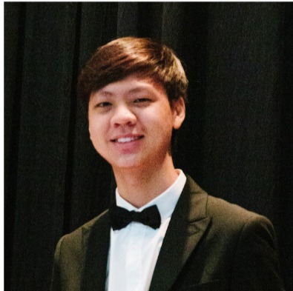
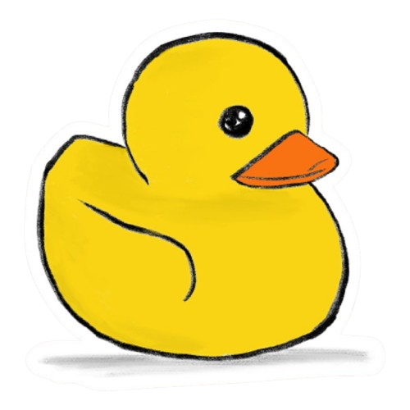
Roles and Responsibilities
Yap Wenn Xuan
Project Manager
Dr. Noor Hasrina Bakar
Supervisor
Notes:
aiman

Slide 14
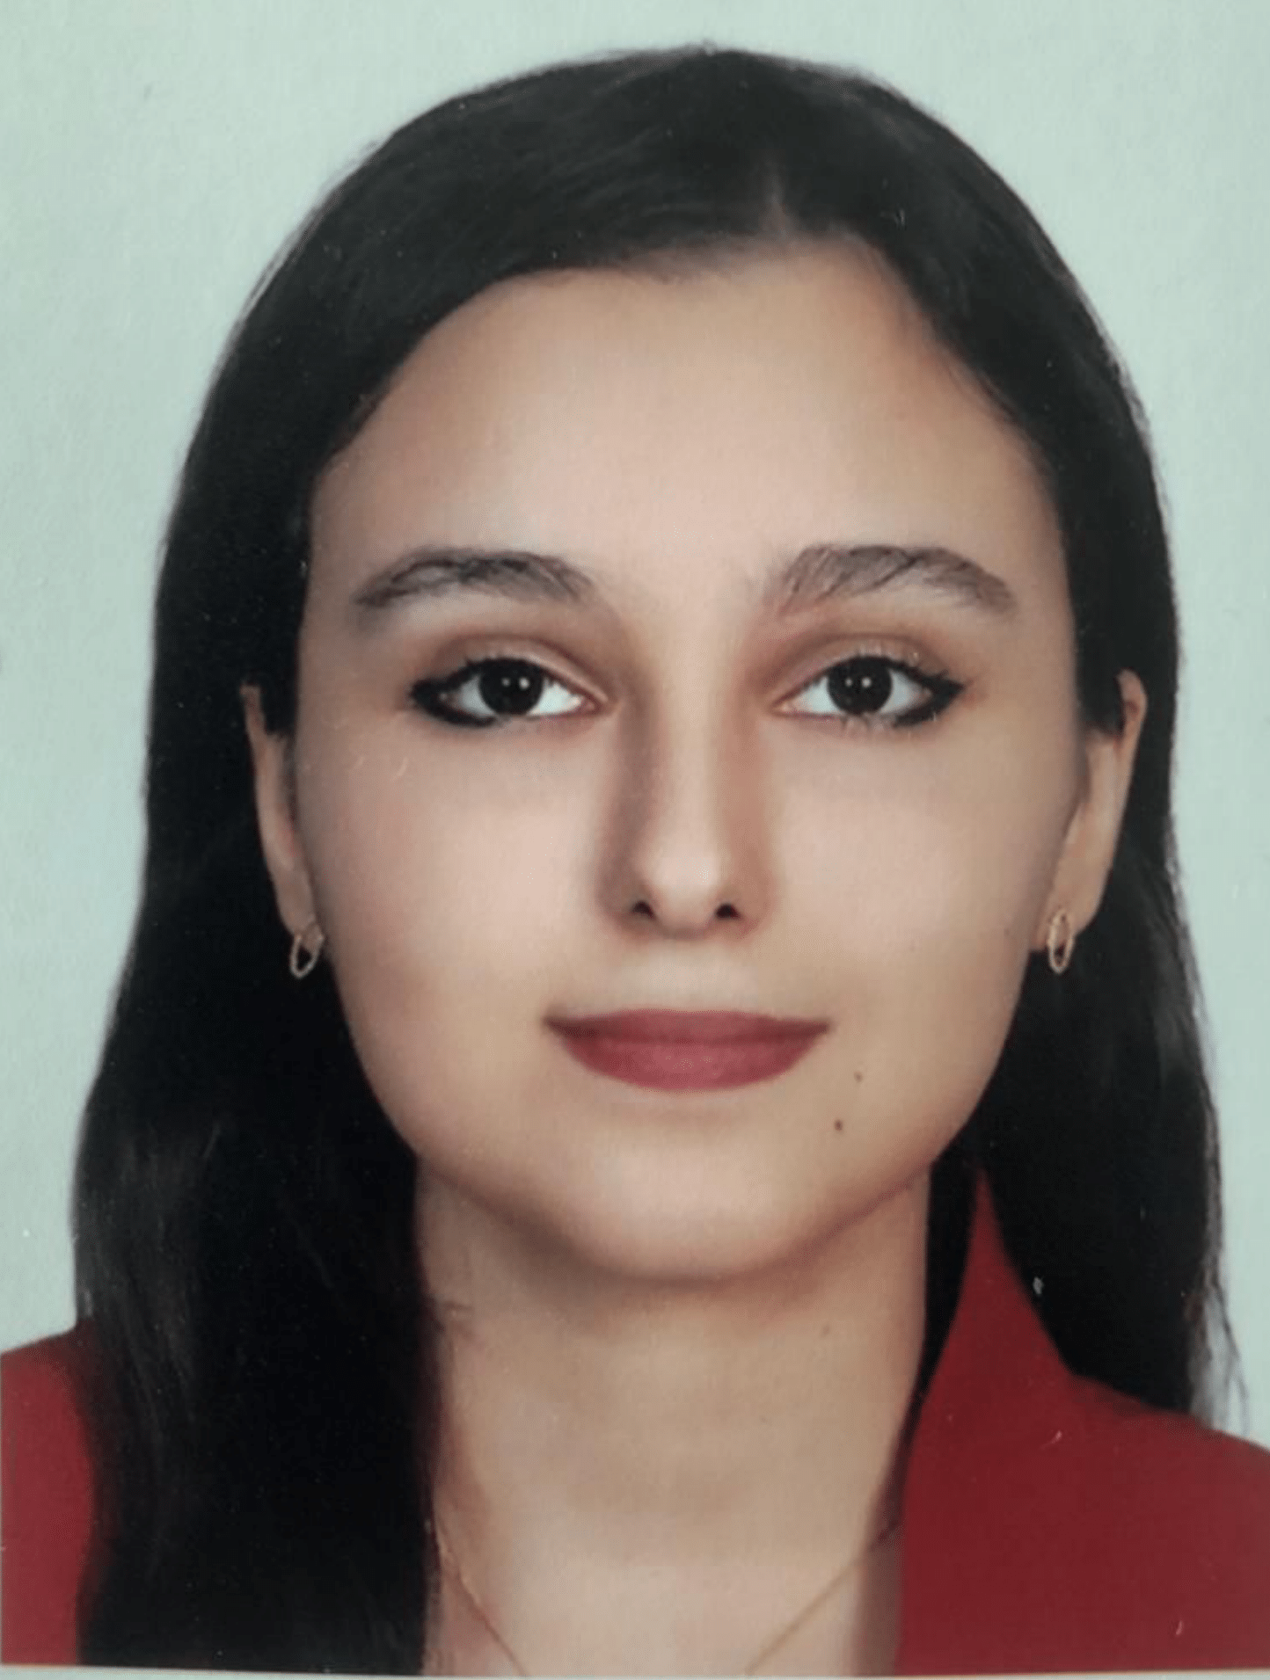
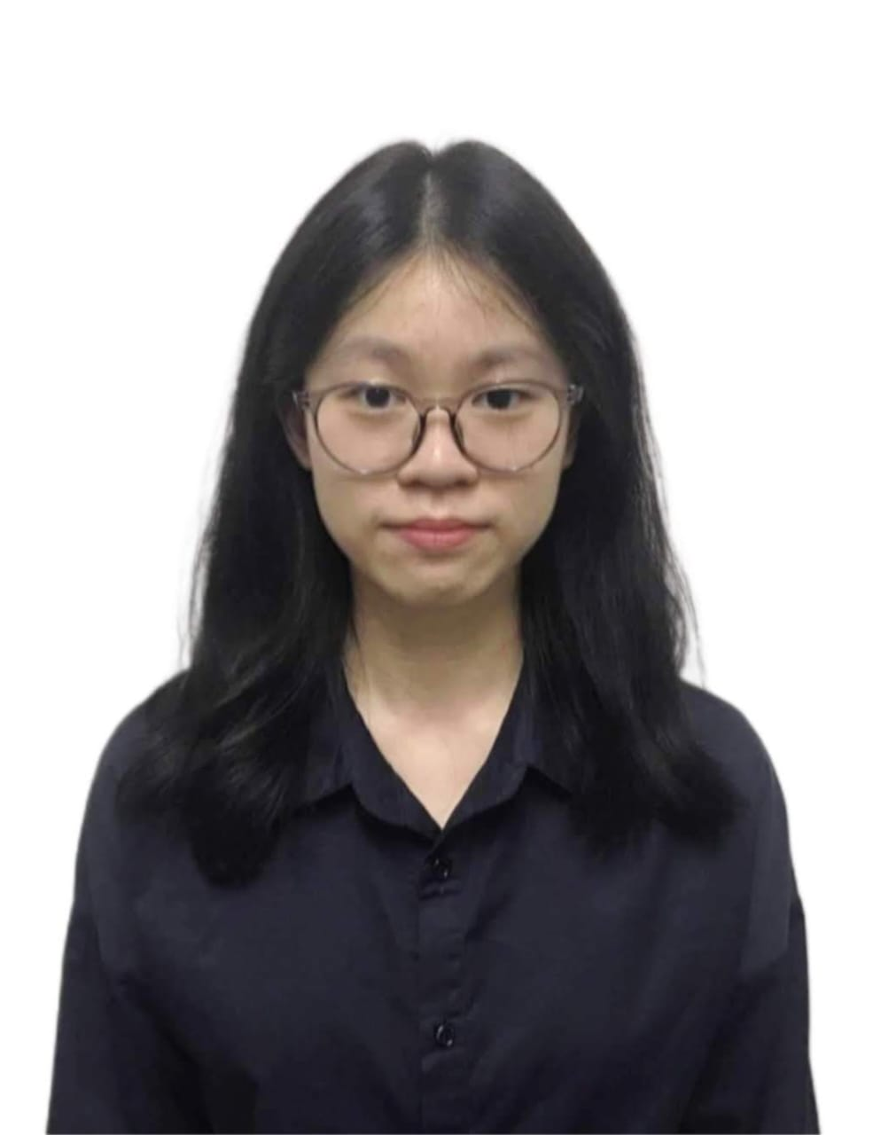
Future
Roles and Responsibilities
About the project
Yap Wenn Xuan
Project Manager
Airin Rashidi
AI Specialist
Teh Kai Yi
AI Specialist
Dr. Noor Hasrina Bakar
Supervisor
Notes:
aiman

Slide 15
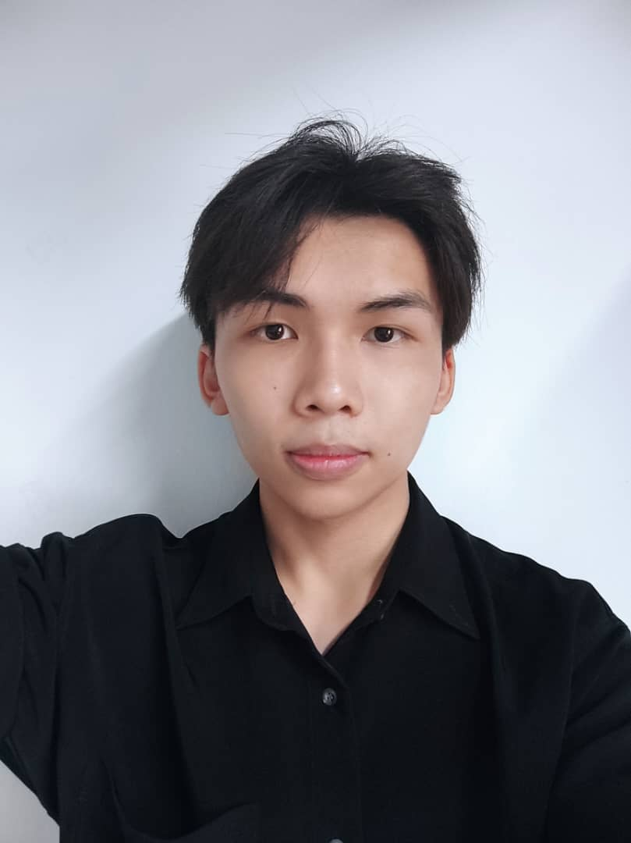
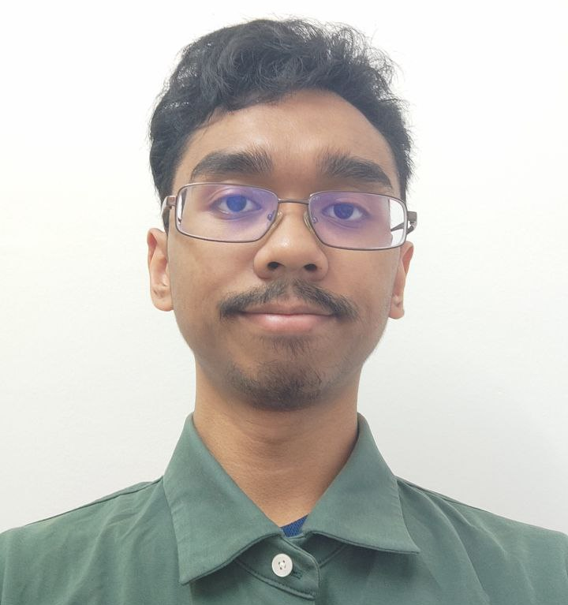
Future
Roles and Responsibilities
About the project
Yap Wenn Xuan
Project Manager
Airin Rashidi
AI Specialist
Teh Kai Yi
AI Specialist
Moh Shao Long
Security &
Programming
Aiman Hazim
Game Design &
Programming
Dr. Noor Hasrina Bakar
Supervisor
Notes:
aiman

Slide 16
Roles and Responsibilities
About the project
Yap Wenn Xuan
Project Manager
Airin Rashidi
AI Specialist
Teh Kai Yi
AI Specialist
Moh Shao Long
Security &
Programming
Aiman Hazim
Game Design &
Programming
Dr. Noor Hasrina Bakar
Supervisor
Notes:
aiman

Slide 17
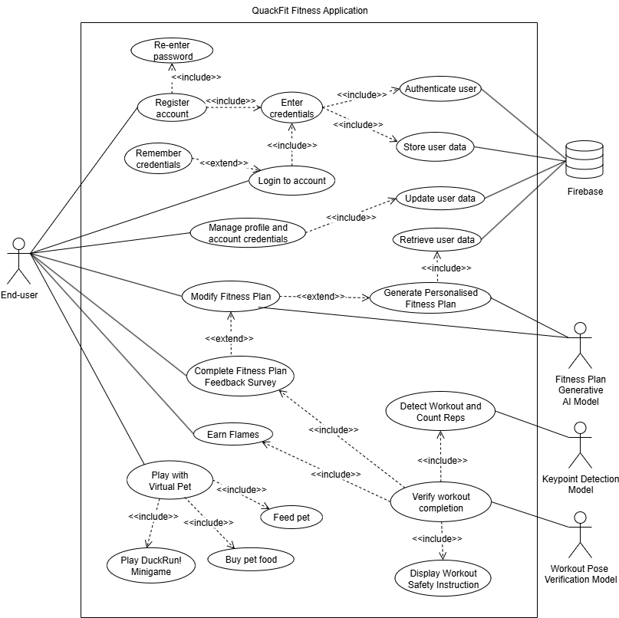
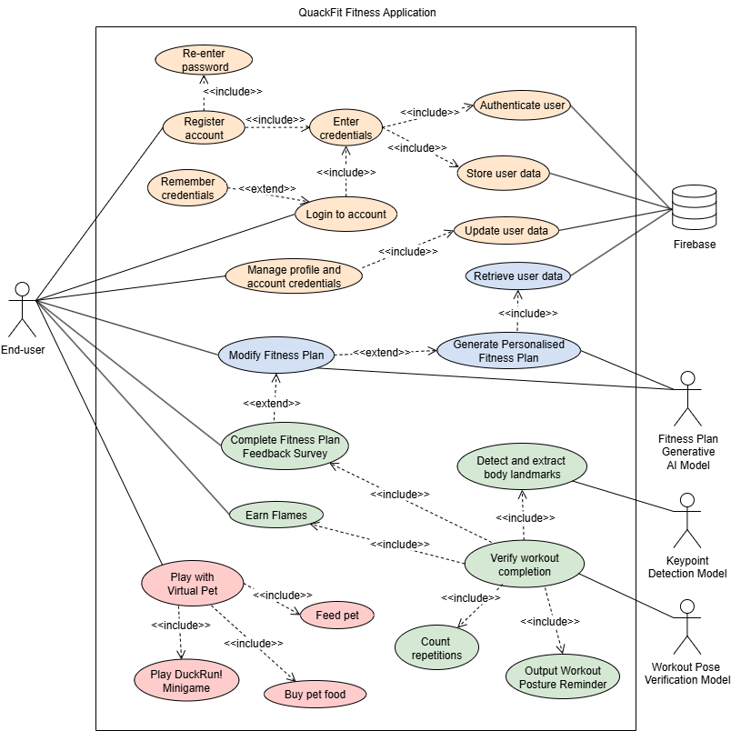
Use Case Diagram
Landmark Detection Model
Workout Pose Classification AI Model
Key Functionalities Overview
Notes:
aiman

Slide 18
Use Case Diagram
Key Functionalities Overview
Landmark Detection Model
Workout Pose Classification AI Model
Notes:
aiman

Slide 19
Key Functionalities Overview
USER ACCOUNT MANAGEMENT
FITNESS PLAN PERSONALISATION
WORKOUT VERIFICATION
VIRTUAL PET COMPANIONSHIP
Landmark Detection Model
Workout Pose Classification AI Model
Notes:
aiman

Slide 20
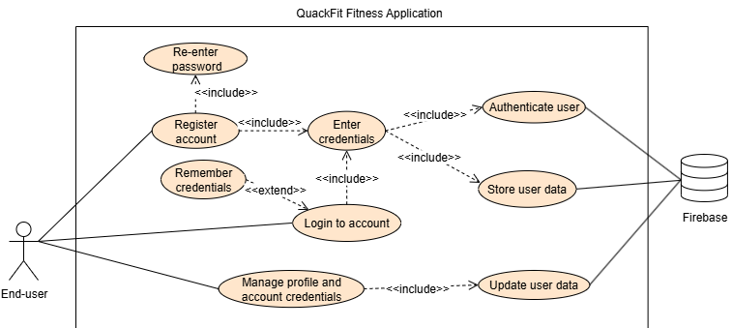
USER ACCOUNT MANAGEMENT

Slide 21
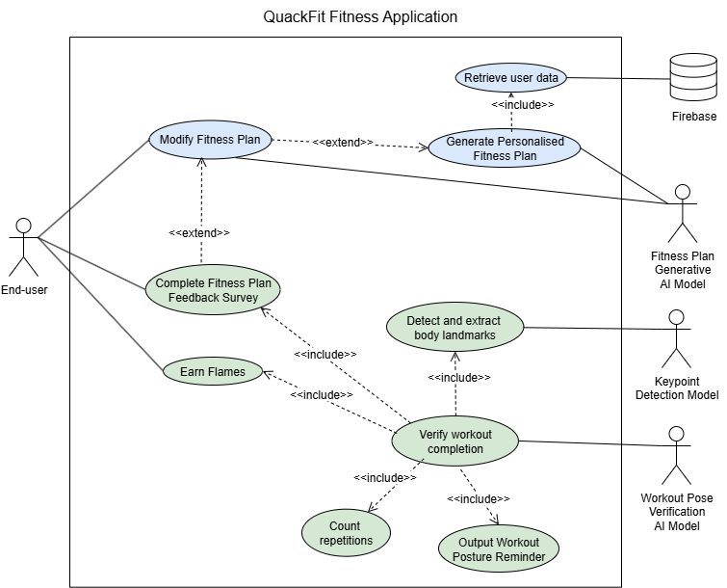
WORKOUT VERIFICATION
FITNESS PLAN PERSONALISATION

Slide 22
WORKOUT VERIFICATION
Landmark Detection Model
Workout Pose Classification AI Model
FITNESS PLAN PERSONALISATION

Slide 23
WORKOUT VERIFICATION
MLKit
Pose Detection Model
WORKOUT VERIFICATION
A Computer Vision Framework by Google
Captures Human Body Landmark Coordinates
Landmark Detection Model
33 Landmarks
in Total
Workout Pose Classification AI Model

Slide 24
WORKOUT VERIFICATION
Workout Pose
Classification Model
WORKOUT VERIFICATION
Dense Neural Network (DNN) model
Trained on 500+ Workout Pose
Landmark Data
Landmark Detection Model
Generates Pose Confidence Score
for Inputted Landmark Data
Workout Pose Classification AI Model

Slide 25
WORKOUT VERIFICATION
1.
Landmark Detection Model
Workout Pose Classification AI Model

Slide 26
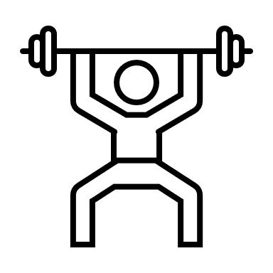


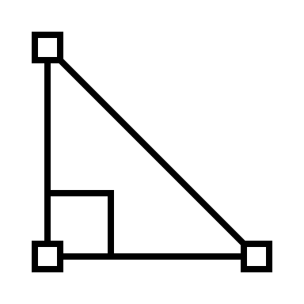
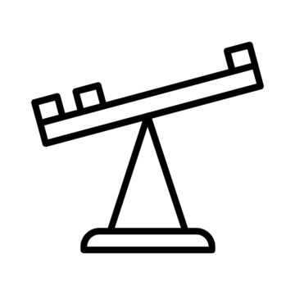
Extract landmark data from camera frames
WORKOUT VERIFICATION
Input landmark data to model
1.
Model generates confidence score
Landmark Detection Model
Compare confidence score with threshold
Workout Pose Classification AI Model
Increment
repetition count if
score > threshold

Slide 27
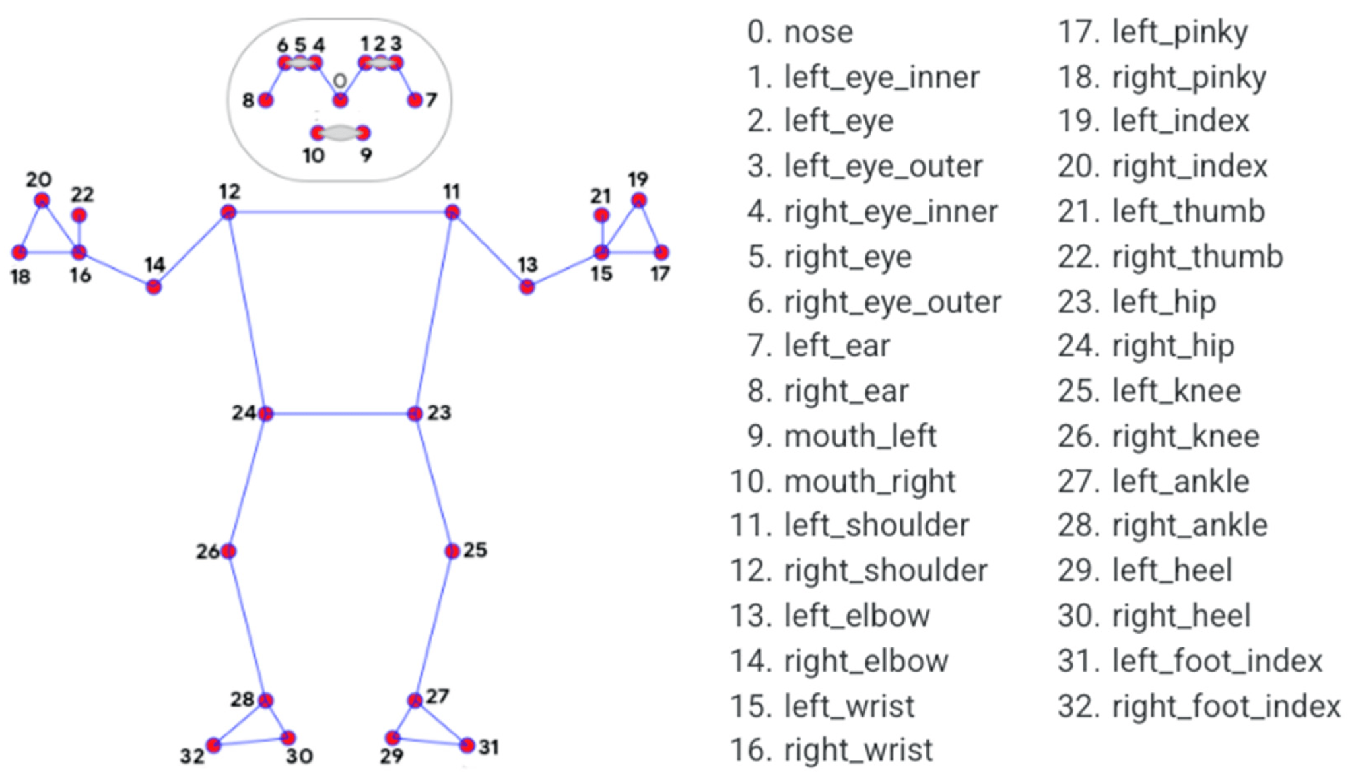
PoseDetector from Google’s MLKit automatically detects user’s body landmark coordinates in each frame of the video
Extract landmark data from camera frames
Interpreter loads the trained DNN model and processes the received landmark coordinates from each frame
Input landmark data to DNN model
DNN Model generates pose confidence score
Compares pose confidence score with threshold
Increment
repetition count if score > threshold

Slide 28
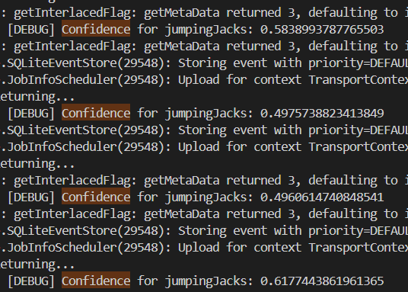
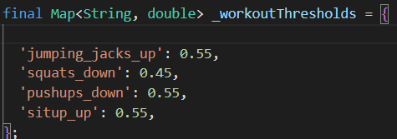
Extract landmark data from camera frames
Input landmark data to DNN model
Generates pose confidence score for each frame
DNN Model generates pose confidence score
Compares pose confidence score with threshold
Increment
repetition count if score > threshold

Slide 29
WORKOUT VERIFICATION
Landmark Detection Model
2.
Workout Pose Classification AI Model

Slide 30
WORKOUT VERIFICATION
Landmark Detection Model
3.
Workout Pose Classification AI Model

Slide 31
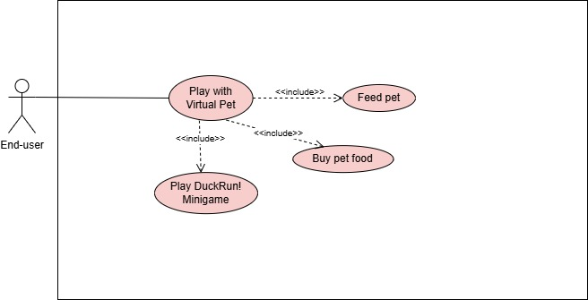
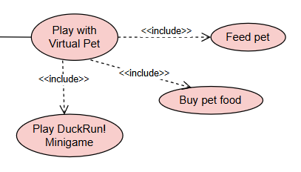
Virtual Pet Companionship
VIRTUAL PET COMPANIONSHIP

Slide 32
USER ACCOUNT MANAGEMENT
FITNESS PLAN PERSONALISATION
WORKOUT VERIFICATION
Landmark Detection Model
VIRTUAL PET COMPANIONSHIP
Workout Pose Classification AI Model

Slide 33
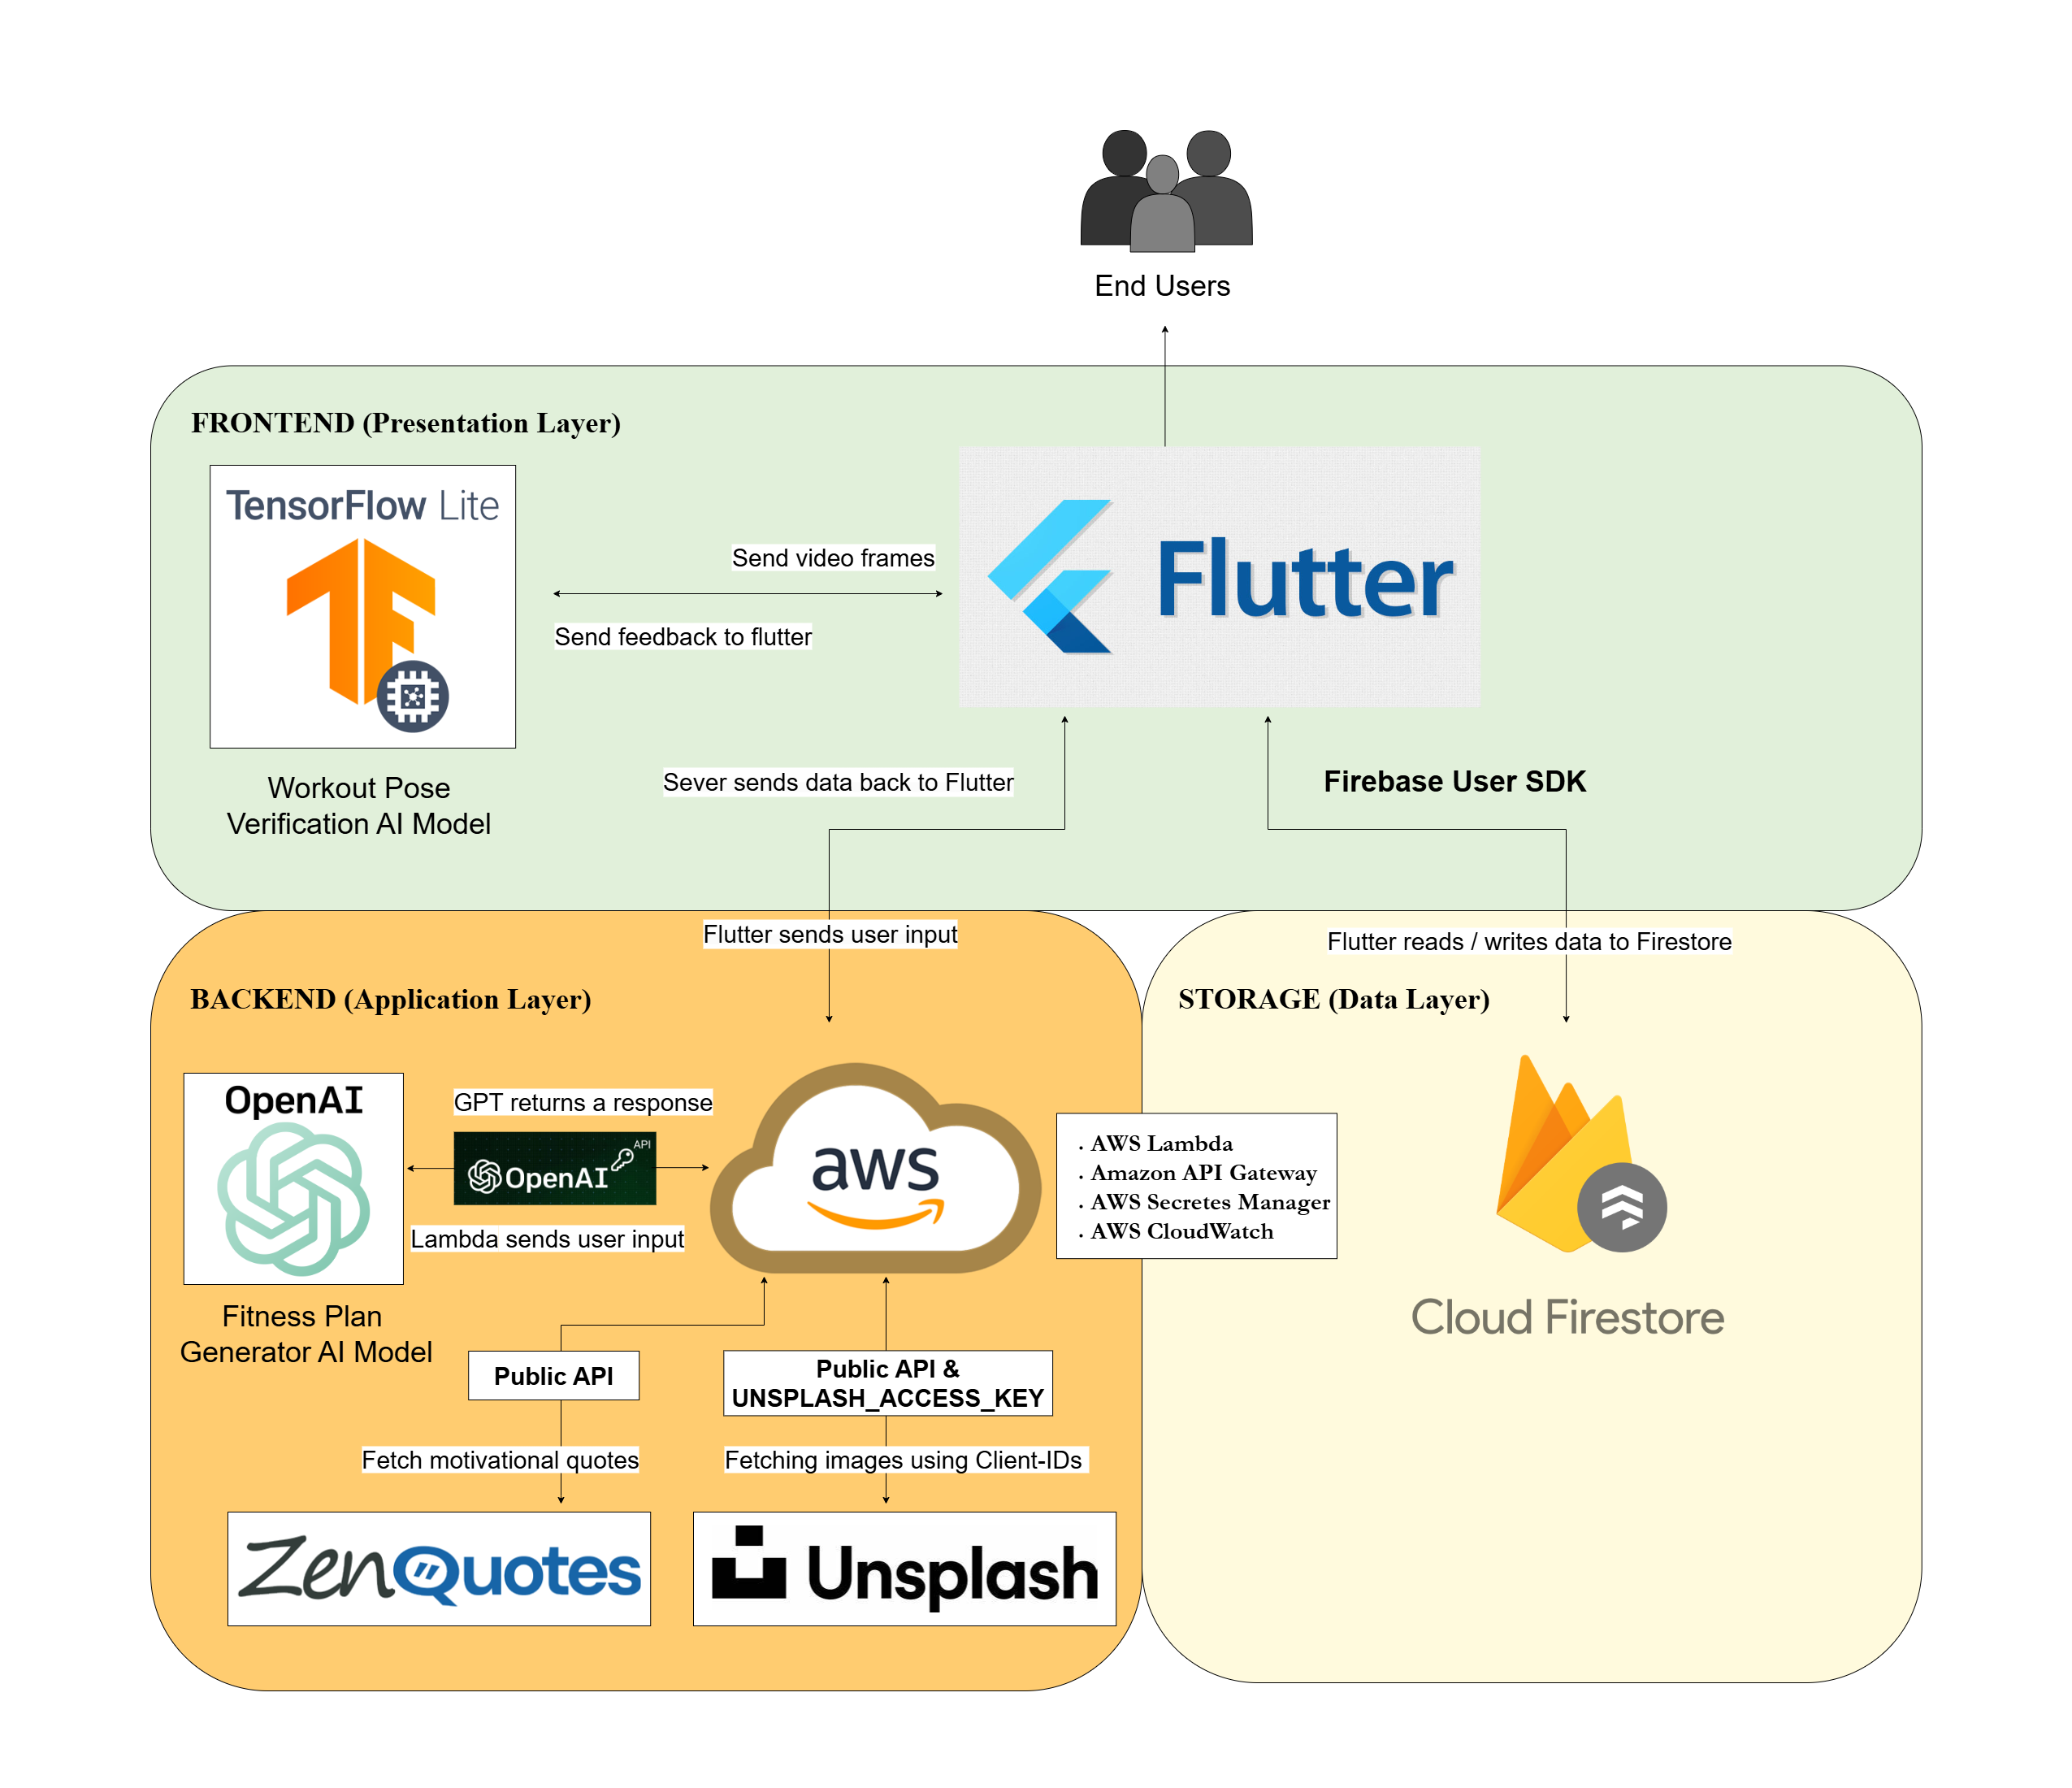
Architecture Diagram
Notes:
aiman

Slide 34
On-Device Execution
Community and Plugin Ecosystem
Real time Performance
Hot Reloads
Notes:
aiman

Slide 35

Amazon API Gateway
AWS Lambda
AWS Secretes Manager
AWS CloudWatch
Notes:
aiman

Slide 36
NoSQL database
Auto offline support
No manually set up DB. sec
Flexible Querying data
Auto scale and storage management
Notes:
aiman

Slide 37
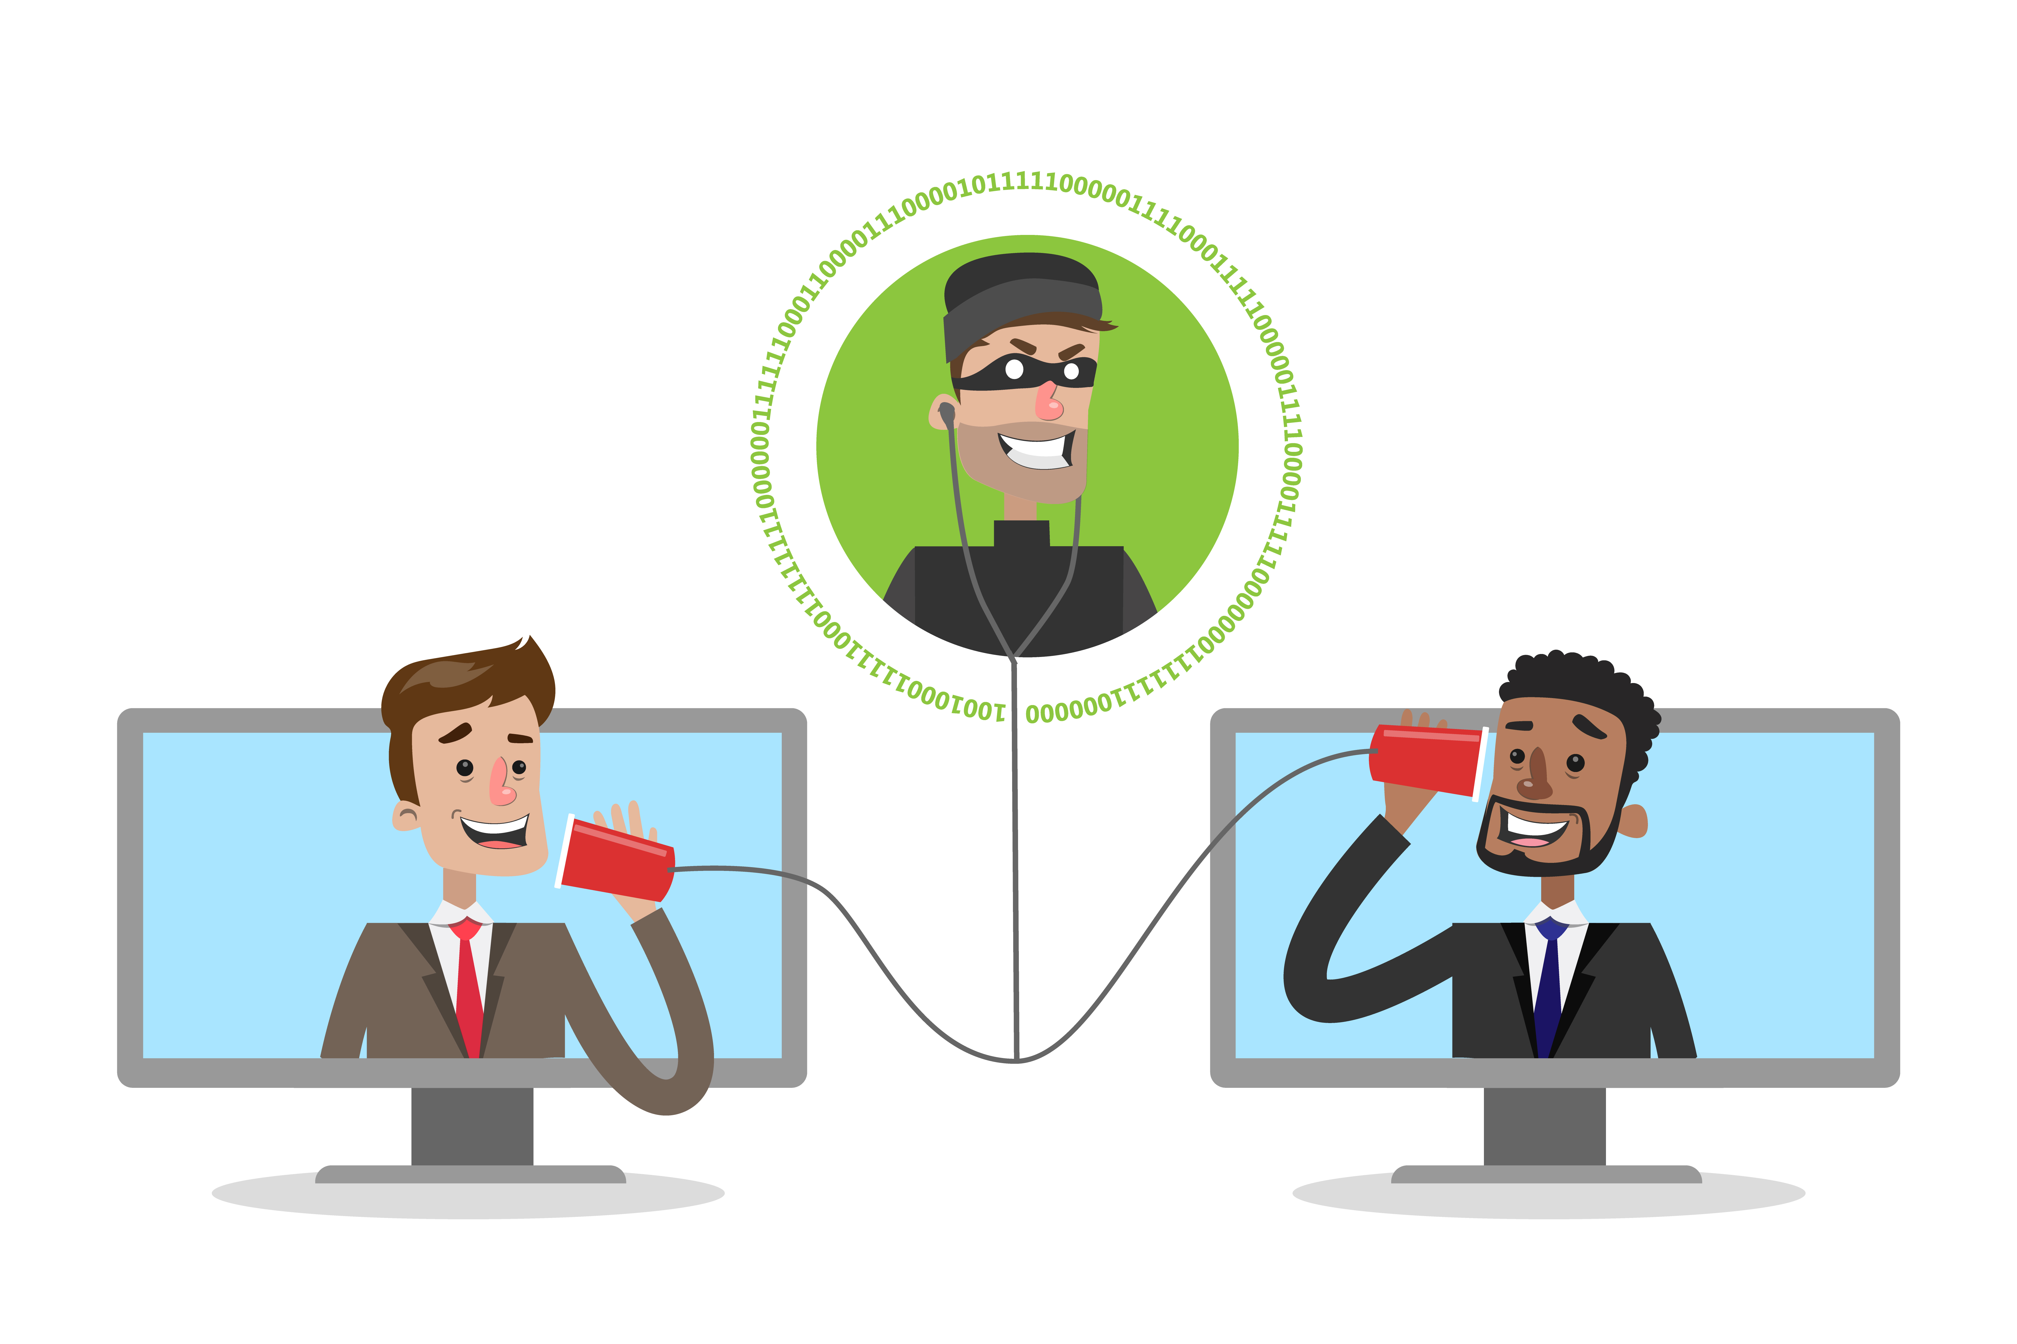
TLS 1.3
AES-256
Notes:
aiman

Slide 38
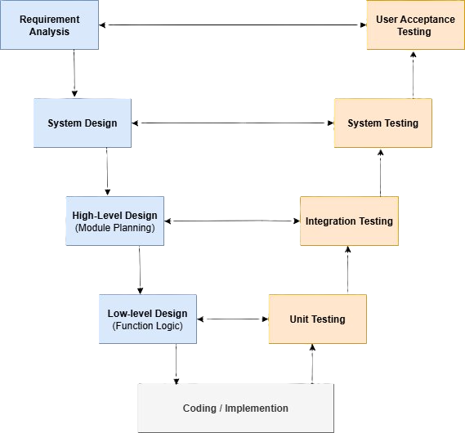
Testing Methodology

Slide 39
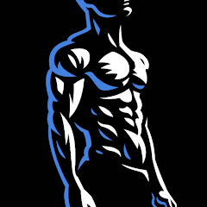


Future
Similar applications
BetterMen
Notes:
aiman

Slide 40
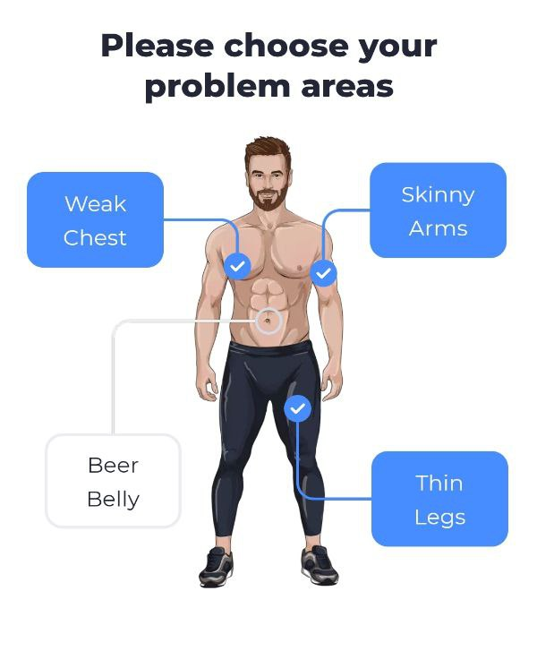
Future
Similar applications
Blast
BetterMen
Notes:
aiman

Slide 41
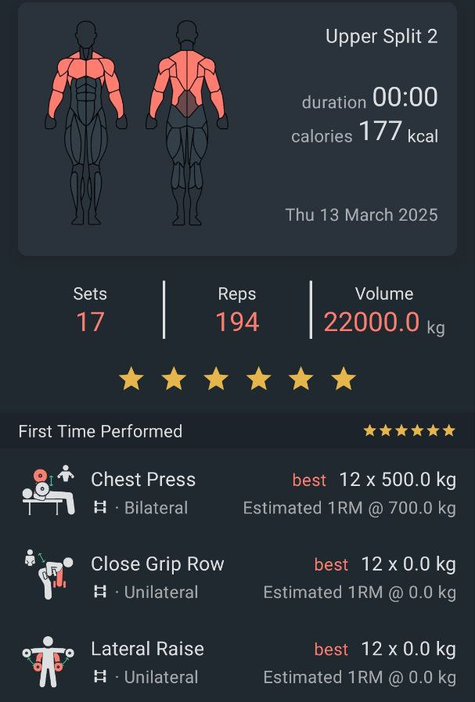
Future
Similar applications
Workout Quest
Blast
BetterMen
Notes:
aiman

Slide 42
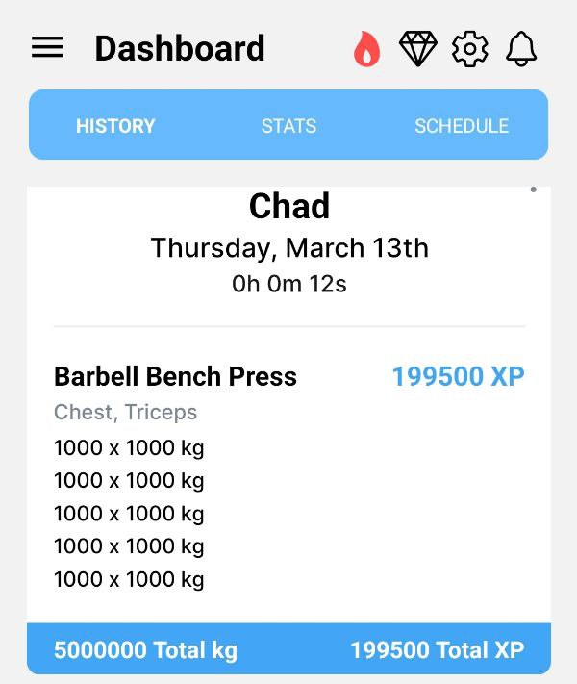
Future
Similar applications
Workout Quest
Blast
Notes:
aiman

Slide 43
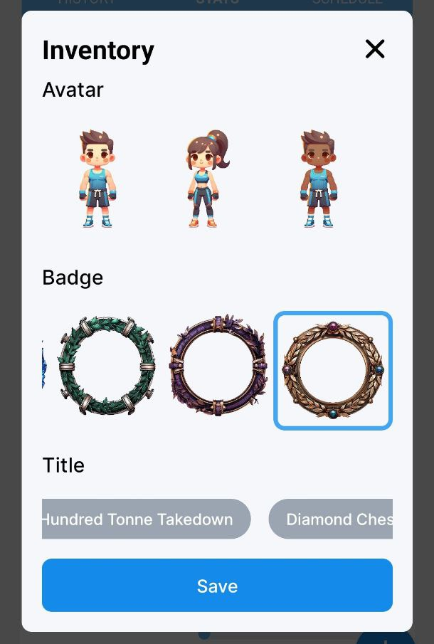
Future
Similar applications
Workout Quest
Notes:
aiman

Slide 44
Application Demo

Slide 45
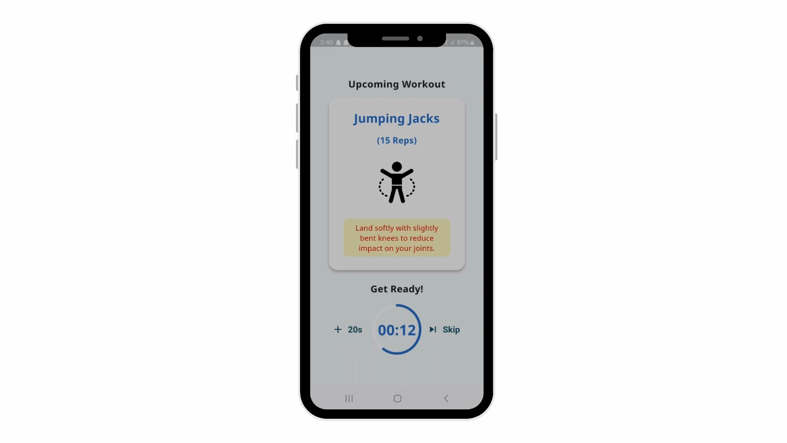
Workout Verification Demo

Slide 46
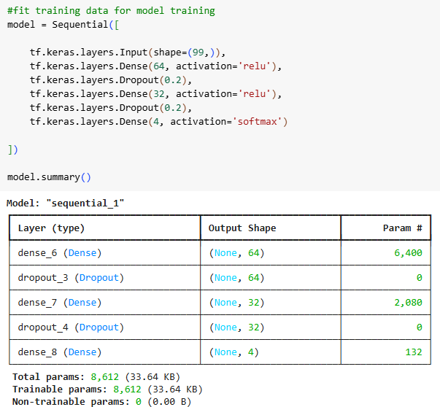
DNN Model Architecture

Slide 47
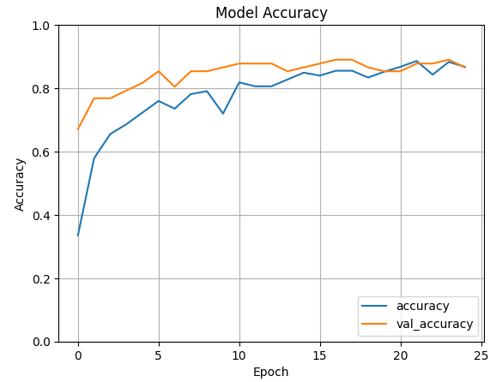
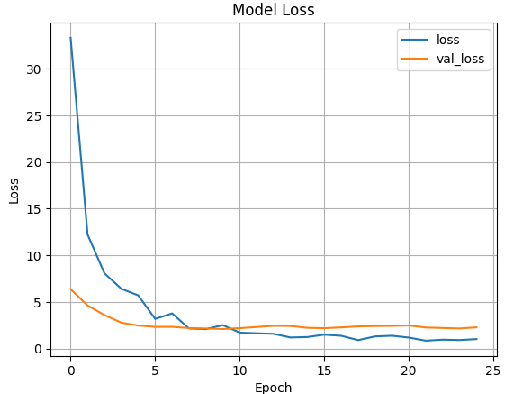
DNN Model Training Process
Notes:
Just incase they wanna see this during qna

Slide 48
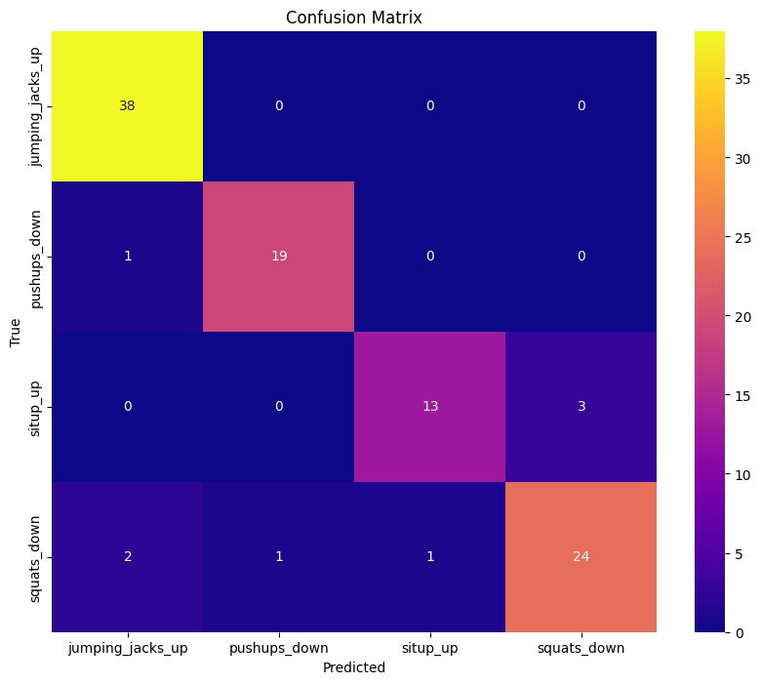
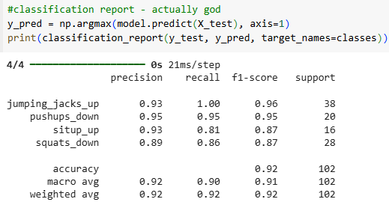
DNN Model Evaluation
Classification Report
Notes:
Just incase they wanna see this during qna

Slide 49
References
Nik-Nasir, N. M., Md-Yasin, M., Ariffin, F., Mat-Nasir, N., Miskan, M., Abu-Bakar, N., & Yusoff, K. (2022). Physical Activity in Malaysia: Are We Doing Enough? Findings from the REDISCOVER Study. International Journal of Environmental Research and Public Health, 19(24), 16888. https://doi.org/10.3390/ijerph192416888
Tong, H. L., Quiroz, J. C., Kocaballi, A. B., Ijaz, K., Coiera, E., Chow, C. K., & Laranjo, L. (2022). A personalized mobile app for physical activity: An experimental mixed-methods study. Digit Health, 1-13. 10.1177/20552076221115017
Kurup, H. S., Dr. Anjali.O, & K.G, D.S. (2022). Impact Of Social Media And Fitness Apps On The Health And Exercise Habits Of Modern Population. Journal of Advanced Zoology, 43(1), 929-931. https://www.researchgate.net/publication/380996383_Impact_Of_Social_Media_And_Fitness_Apps_On_The_Health_And_Exercise_Habits_Of_Modern_Population
‌
Notes:
Jon
Inttro team

